Slide 1

Discover a Powerful
Tax Credit Program That Goes Beyond Education
October 22, 2025 | RSVP Volunteers

Slide 2



Meet the Presenters
Michael Shorr
SEPA Regional Director
PA Department of Community
& Economic Development
Betsy Roush
​
VP, Community Relations
Univest
Lydia Messinger
​
Development Manager
RSVP Volunteers

Slide 3
Neighborhood Assistance Program (NAP)
DCED Southeast Regional Office
RSVP NAP Presentation – 10/22/2025
Application Window:
March 1, 2026 – May 30, 2026
Michael Shorr
Regional Director
Southeast PA: Bucks, Chester, Delaware, Montgomery, and Philadelphia

Slide 4

NAP Purpose
Helping Build Successful Communities
The purpose of the Neighborhood Assistance Tax Credit Program (NAP) is to encourage collaboration between non-profit organizations and businesses to improve communities for low-income populations in specific geographic locations throughout Pennsylvania.
Collaboration occurs in the form of corporate contributions to
non-profits in return for state tax credits.

Slide 5
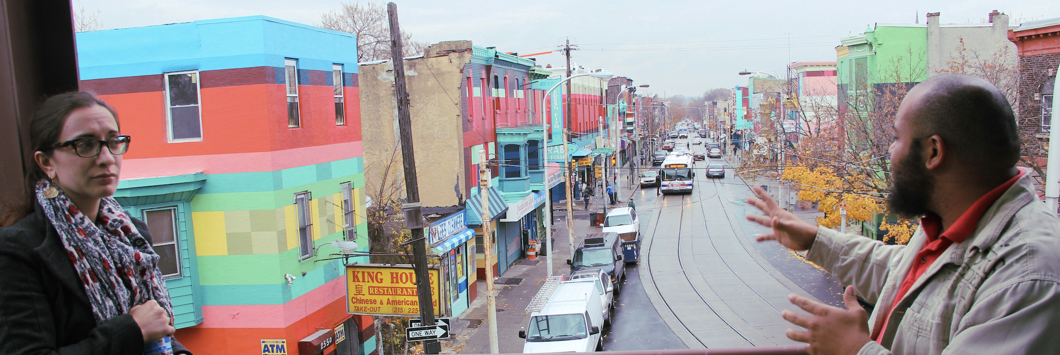

NAP Program Overview
Eligibility
Neighborhood non-profits
Assistance
$72 million in tax credits available annually
More information
dced.pa.gov/nap
NAP helps non-profit organizations and businesses with collaboration to improve the conditions for low-income populations in communities throughout Pennsylvania.

Slide 6
Components of NAP

Slide 7
General Requirements
Beneficiaries
Low-Income Communities or Households located in distressed or impoverished areas within Pennsylvania.
A low-income household is defined as a person and their immediate family for which, during the twelve months immediately preceding the date of application for services:
Total income does not exceed 150 percent of the federal poverty level as established annually by the federal Office of Management and Budget; or
Total income does not exceed 80 percent of the median income of the targeted area; or
Total income meets the income requirements of another applicable government program
DCED Eligible Designations
Enterprise Zones (EZ)
Keystone Opportunity Zones (KOZ)
Keystone Opportunity Expansion Zones (KOEZ)
Main Street Matters designees
Elm Street designees
Act 47 Municipalities
Cities (first-class, second-class, second-class A, and third-class)

Slide 8
General Requirements
Distressed Area
A distressed area must demonstrate, in comparison to county and statewide averages, a high incidence of one or more of the demographic factors set forth below:
Persistent unemployment or underemployment
Dependence upon public assistance
Overcrowded, unsanitary, or inadequate housing
Crime and delinquency
School dropouts or other evidence of low educational attainment
Vacant and dilapidated properties, blight, or
Other generally accepted indicators of widespread social problems
DCED Eligible Designations
Enterprise Zones (EZ)
Keystone Opportunity Zones (KOZ)
Keystone Opportunity Expansion Zones (KOEZ)
Main Street Matters designees
Elm Street designees
Act 47 Municipalities
Cities (first-class, second-class, second-class A, and third-class)

Slide 9
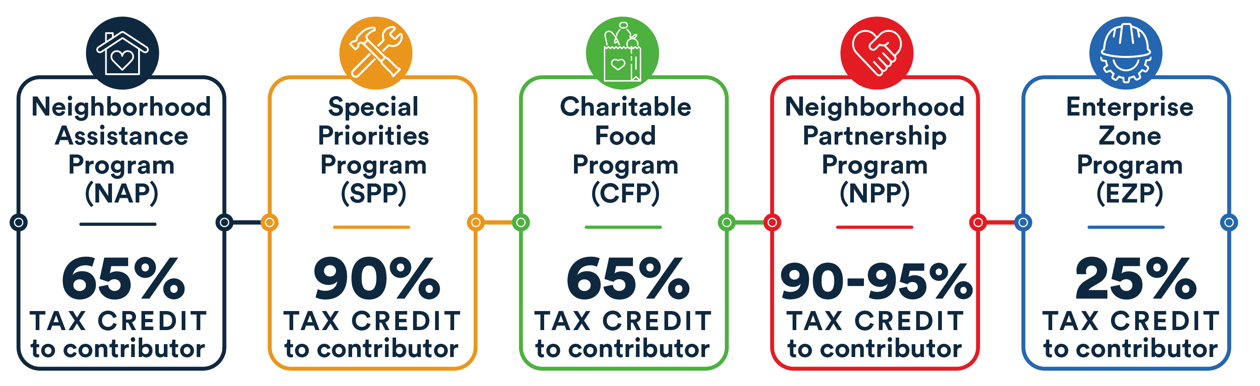
Tax Credits Per Sub-Program
DCED does not offer actual dollars for funding. Funding is between contributor and awardee.

Slide 10

Overview
Eligible activities*
Affordable Housing
Community & Civic Engagement
Community Economic Development
Community Services
Crime Prevention
Education
Job Training
Neighborhood Assistance
Neighborhood Conservation
Transportation
*This is not an exhaustive list of eligible activities. Contact your regional DCED representative to discuss your project and receive technical assistance.
Neighborhood Assistance Program (NAP)
Address neighborhood and community problems
Benefit low-income persons and/or residents of economically distressed neighborhoods
One year project
65% tax credit to contributor

Slide 11

Overview
Special Priorities
Program (SPP)
Special Priorities
Affordable Housing Support Services
Affordable Housing Development
At-Risk and Vulnerable Populations Initiative
Blight Elimination
Disaster or Economic Recovery
Diversity Initiatives
Healthcare Equity
Rural Initiatives
Veteran Initiatives
Demonstrate a significant impact on needs in a targeted area(s)
Based on collaboration, partnerships, and goals
One year project
90% tax credit to contributor

Slide 12


Overview
Charitable Food
Program (CFP)
Assists low-income populations through:
Regional Food Banks
Pantries
Soup Kitchens
Shelters
Feeding Centers providing food packages or meals
Non-profit Emergency Food Suppliers
Innovative Food Resource Projects
Improve food security in Pennsylvania
Support new or innovative food-related projects
One year project
65% tax credit on eligible contributions,
including food and other tangible goods

Slide 13

Overview
Neighborhood Partnership
Program (NPP)
Eligible activities
Affordable Housing
Community Economic Development
Community Services
Crime Prevention
Education
Job Training
Neighborhood Assistance
Neighborhood Conservation
Improve access to job and economic opportunities, quality education, affordable housing, quality-of-life amenities, or another key factor in building healthy communities
Collaboration between the non-profit & other community orgs
Must establish a Neighborhood Partnership Advisory Committee and include a Community or Strategic Plan
Large scale: minimum five-year commitment-renew contract every year; 90% tax credit per year
Six or more-year commitment earns an 95% credit per year
$50,000 minimum individual contribution amount and with a minimum total application amount of $100,000

Slide 14

Overview
Enterprise Zone
Program (EZP)
Eligible activities
Acquisition
Architecture
Engineering
Expansion
Improvement to a building(s)
Improvement to land
Rehabilitation
Must be within part of a designated Enterprise Zone, Main Street, or Elm Streets
Credits are given to approved private for-profit companies making investments to construct, rehabilitate, expand, and improve buildings or land that promote community development and create employment opportunities for low-income individuals located in zones
25% tax credit to investor up to $500,000
Current Active EZ: Bucks County (Bristol, Levittown, Bensalem, Lower Southampton, Morrisville, Penndel, Tullytown, Falls Township )
Main Street: Quakertown, PA

Slide 15
2025-2026 Project Priorities
In FY2025-26, the Department will prioritize applications that align with the vision and goals of newly developed Commonwealth’s Housing Action Plan & Economic Development Strategy. These priorities include:
  Affordable Housing Development
  Affordable Housing Support Services
  Blight Elimination
  Community Economic Development
  Workforce Development & Job Training

Slide 16
Understanding and Using Tax Credits

Slide 17


Understanding Tax Credits
Deduction
Credit
Reduce taxable income.
Can be itemized or standard.
The more income made, the more valuable a deduction.
Some deductions are limited based on your income and other factors.
Charitable contribution.
A tax credit is an amount of money a taxpayer can subtract from the amount of tax they owe to the government.
Tax credit programs such as NAP do not offer actual dollars for funding.
Tax credits are intended as an incentive for corporate partners to contribute real dollars in return for the tax credit.
*NAP tax credits may be used the year of contribution or during one of the 5 subsequent years.

Slide 18

Tax Details
Taxes Eligible for NAP Deductions
Corporate Net Income
Bank and Trust Company Shares Tax
Title Insurance Company Shares Tax
Insurance (Gross) Premiums Tax
Mutual Thrift Institutions Tax
Personal Income Tax (only if being passed-through from a corporate entity
Eligible contributions
Cash
In-Kind (e.g. equipment, food, real estate, etc.)
Job Training
Real Estate Contribution
Technical Assistance
DCED does not provide tax advice, and it is up to the business entity to consult their tax advisors concerning how their tax credits can and should be used.

Slide 19
Obtention and Utilization of Tax Credits
Contributor awarded NAP may exercise four options for use of the credits
Retain and Use
Carry-Forward
Sell or Assign
Pass through to another eligible entity
Tax credits claimed will be first applied against the unpaid tax liability in which the credit is approved
Tax Credits provided by this article may be carried forward a maximum of five years
A taxpayer may not carry back or obtain a refund of any portion of an unused credit
A taxpayer, upon application to and approval by DCED, may sell or assign, in whole or in part, unused credits after the taxpayer has held the approved NAP credits for one (1) year

Slide 20
Contribution and Activity Details
Contributor: July 1, 2025 - June 30, 2026 (aligns with state fiscal year)
  Contributor has 18 months (December 31) after start of the fiscal year to submit the Application for Tax Credit with proof of contribution to DCED
Non-profit: activity period (15 months) for the non-profit is July 1, 2025, through the following September 30, 2026
*no minimum or maximum project cost request
* NAP and EITC tax credits have separate aggregate limits
Caps on contributions
1 to 3 projects: maximum aggregate tax credit at $1,000,000
4+ projects: maximum aggregate tax credit at $2,500,000

Slide 21



Required Contributor Documentation
Electronic Clearance Form for Tax Credits
Revenue Clearance Form for tax credits must be completed online with the PA Department of Revenue.
Completed when funding commitment is made.
Commitment Letter
On letterhead, dated, and signed.
Provide EIN, legal address, contact name, and email.
Funding commitment amount and program year.
MOU (for NPP only)
Fully executed between non-profit applicant and contributor.
Outlines the multiyear relationship.

Slide 22
Project Timelines

Slide 23
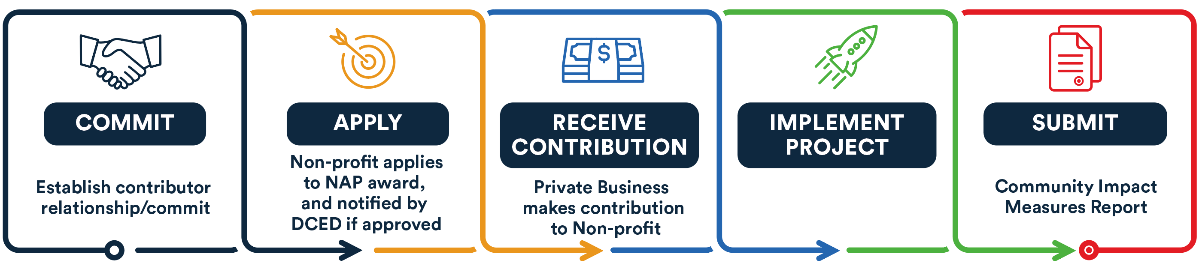
Applicant Timeline
Contribution commitment must be made prior to application by non-profit.

Slide 24
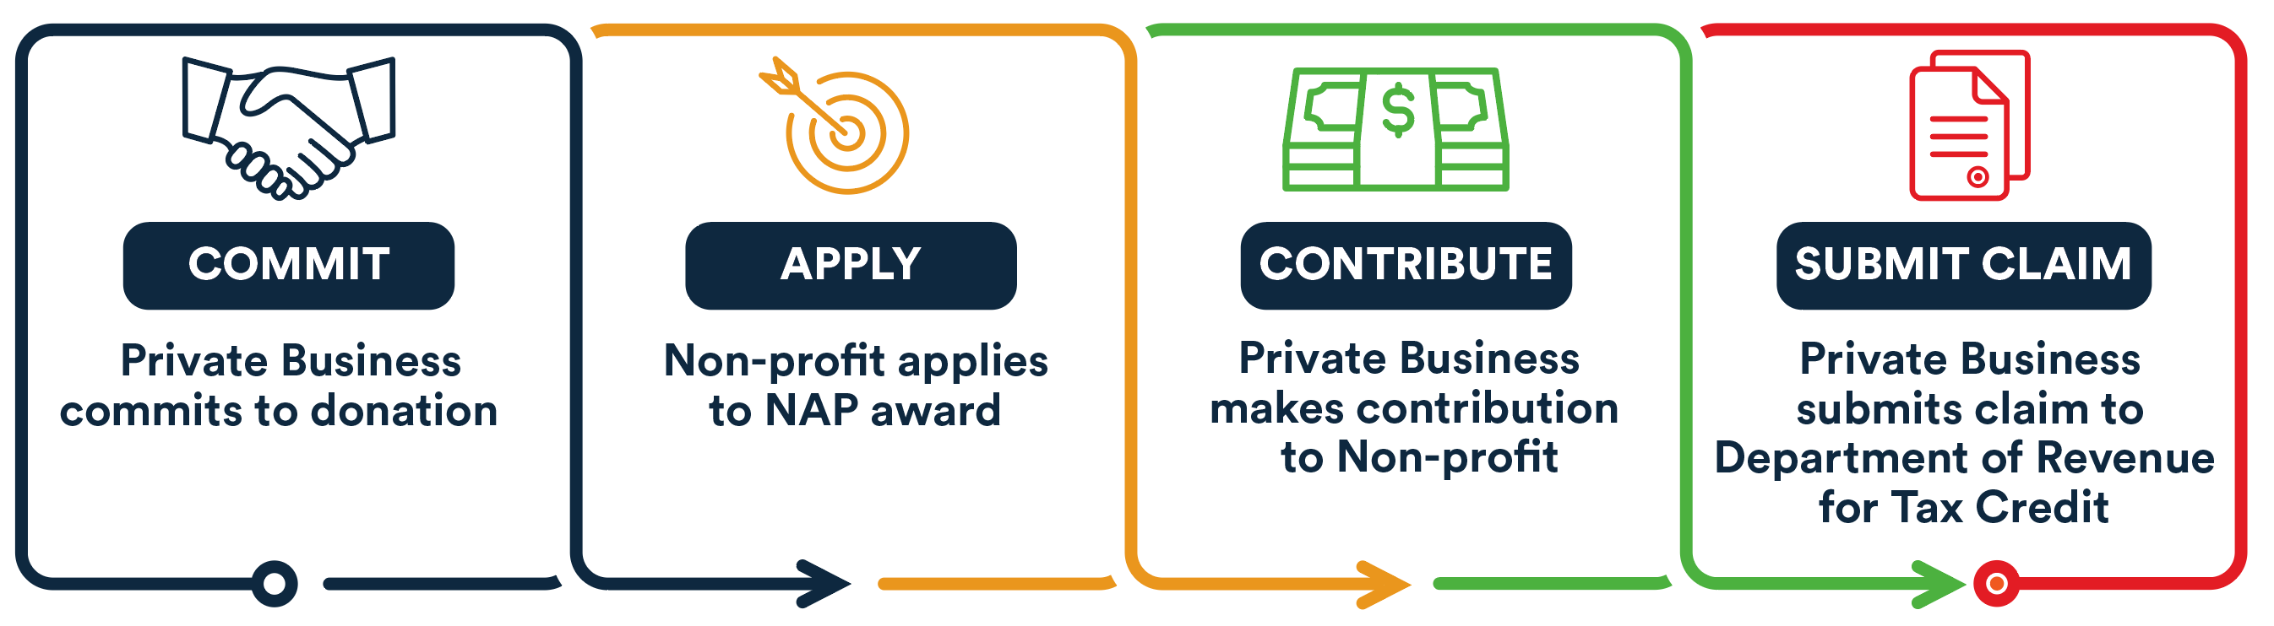
Contributor Timeline
Commitment must be made prior to application submission by non-profit and provided in writing.

Slide 25
Get Connected

Slide 26
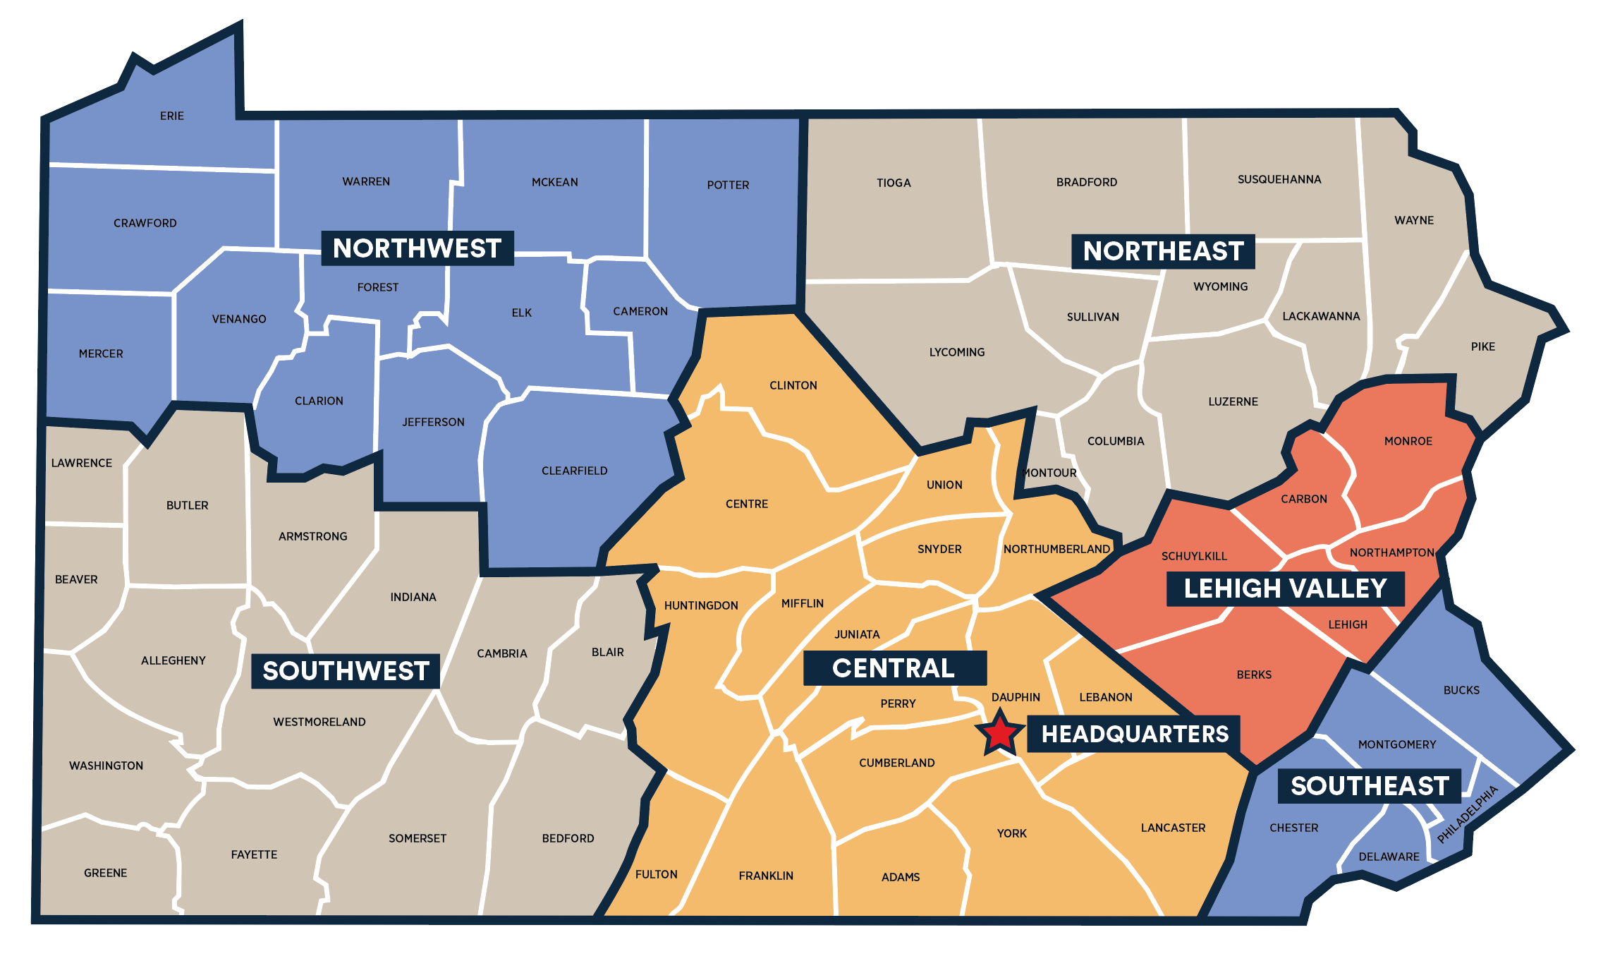
DCED Regional Offices
Northwest
Northeast
Northwest
Christi Martone
cmartone@pa.gov
Southwest
Johnna Pro
jopro@pa.gov
Central
Madra Clay
maclay@pa.gov
Northwest
Paul Macknosky
pmacknosky@pa.gov
Southwest
Fadia Halma
fhalma@pa.gov
Central
Mike Shorr
mshorr@pa.gov
Southwest
Lehigh Valley
Central
Southeast

Slide 27
Michael Shorr
Director, Southeast Regional Office mshorr@pa.gov
215-560-3793

Slide 28
Univest & NAP Support
Neighborhood Assistance Program

Slide 29
Why does Univest participate in NAP?
Tax credit
65-95% tax credit
Most (if not all) projects are CRA eligible
Higher level of support for organizations
Because of the tax credit, we can contribute a larger amount than we can through our philanthropy budget.
Helps build relationships with community organizations that are helping our most vulnerable neighbors.
These gifts have higher impact and typically support low-income distressed neighborhoods.
Neighborhood Partnership Program
Through NPP project commitments, communities can make improvements over a five or six-year period.
This allows them to focus on many different aspects of community development like affordable housing, job training and improving access to job and economic opportunities to move toward sustainable change.

Slide 30
What does the business need to do to participate?
Have conversations with organizations that are planning to apply for funding through NAP
Compile list of recommended projects for approval
Get approval from senior leadership to move ahead with plan
Notify organizations
Submit commitment letter to organization to include with their application to DCED
Complete Electronic Clearance Form for Tax Credits through DCED website
Organization deadline to submit – end of May
Wait for it, wait for it…
Application approvals start to arrive from organizations.
DCED project approval letter arrives for business
Send payments for approved projects
Once payments have been made, business must complete the Application for Tax Credit Under the Neighborhood Assistance Act.
Submit completed form
Proof of Contribution (we use cancelled check)
Project Approval Letter
Send that packet to DCED (via email) and they will send your tax credit certificate.
March/April
May
Summer/Fall
Nov/Dec
January
January 1 - December 31

Slide 31
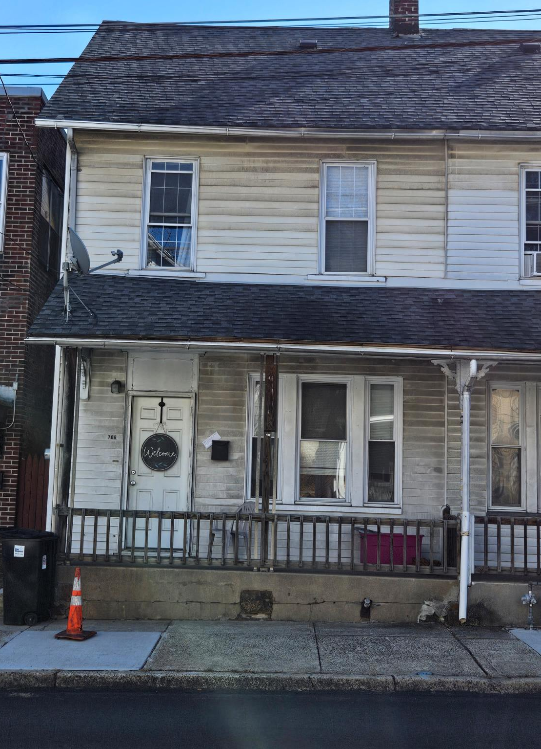
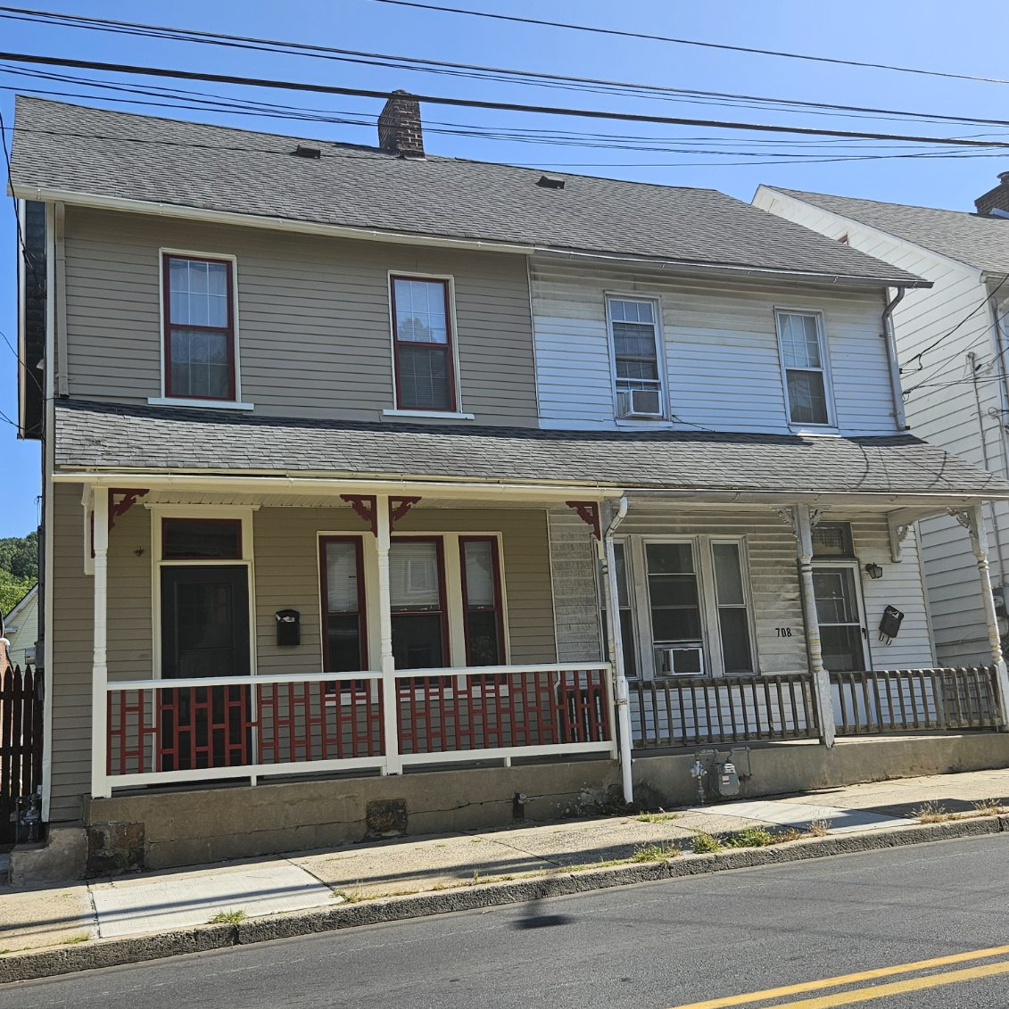

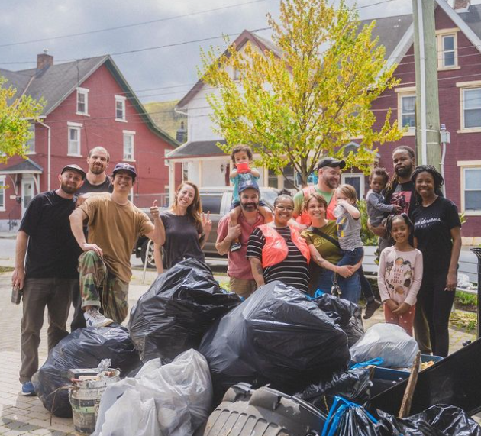
NAP Success Stories
Habitat for Humanity of Philadelphia
Community Action Development Corporation of Bethlehem
Community Action Development Corporation of Bethlehem
Façade improvement grants are also part of the plan to revitalize the Southside of Bethlehem.
Our support helped Habitat Philly complete a 21 Unit Coltrane Commons affordable housing project in Strawberry Mansion.
As part of our current NPP project, Southside Bethlehem has hosted several neighborhood cleanups.
Collaborative effort
City of Bethlehem
Local nonprofits, schools, community groups
Businesses

Slide 32

Challenges

Slide 33
Tips for success with NAP
Get organized!!!
Start small – familiarize yourself with the process and build when you get more comfortable.
If you are unsure or have questions, the team at DCED are extremely helpful, responsive and willing to answer your questions.
Consult your tax professional.
The website is also a great resource. https://dced.pa.gov/programs/neighborhood-assistance-program-nap/

Slide 34
This information is shared as an example of how businesses can participate in the NAP Program.
Please consult your tax professional for advice about how participation would impact your business.

Slide 35

RSVP Mission
RSVP Volunteers creates and runs unique community programs powered by skilled volunteers to advance education and wellness for all ages and strengthen nonprofits through capacity-building and volunteer services.

Slide 36
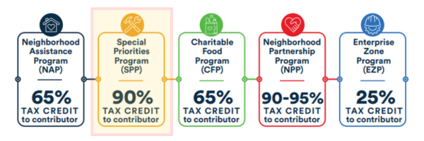
RSVP Qualifies for the SPP Program
  90% state tax credit for businesses
  Qualifies for CRA LMI focus

Slide 37


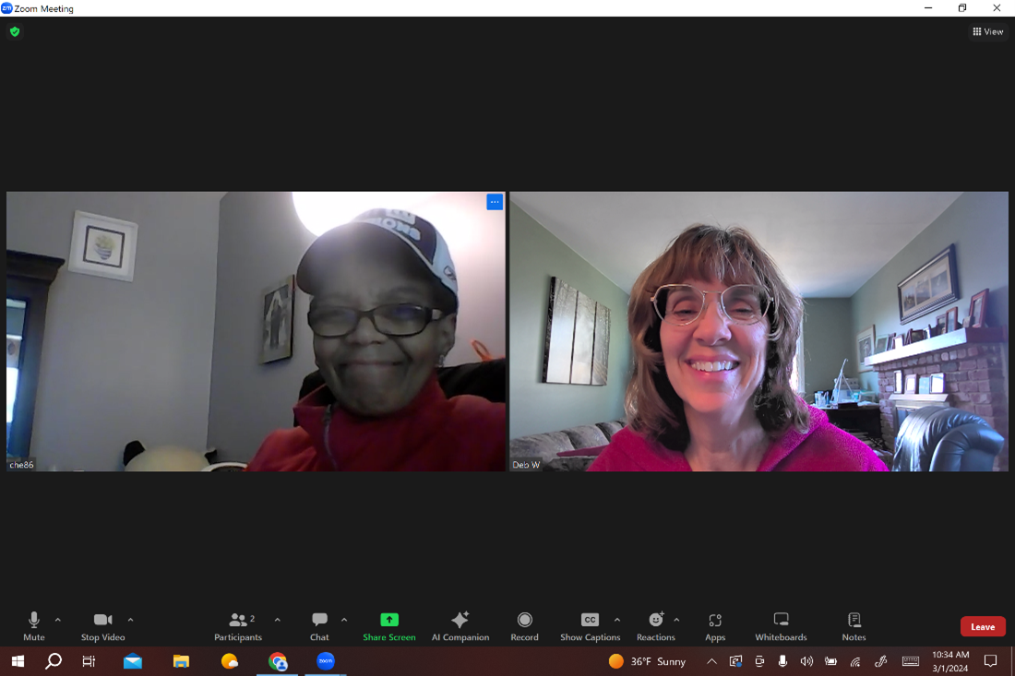
RSVP’s Programming
  Literacy Programming
Supports students preschool-5th grade with in-school
and out-of-school support to build reading and
comprehension skills
  My Free Tutor (Math/STEM Support)
  Provides individual coaching to students 3rd grade
through college to build fundamental skills and
increase math proficiency for disadvantaged students.
  Digital Literacy
  Offers basic digital skills training to adults, helping
them access educational, social, economic, and
workforce development opportunities to eliminate the
digital divide.

